Slide 1
Freelancing Marketplace

Slide 2
Introduction to Members and Contributions:
Member 1:
NAME: ARSHAD ABEDIN ABIR
ID : 22-47188-1
Contribution: Database Design and sign-up paged design and coding
Member 2:
NAME: MD MINHAJUL ISLAM SHIHAB
ID : 22-46389-1
Contribution: Recruiter page, login page Design and coding
Member 3:
NAME: MD RAKIB CHOUWDHURY
ID : 22-46374-1
Contribution: Freelancer page design ,coding and power point presentation
Member 4:
NAME: ARSHAD ABEDIN ABIR
ID : 22-47188-1
Contribution: power point presentation and admin page

Slide 3
DATABASE TABLES:
User:
ID (primary key) - int
username - varchar(50)
password - varchar(50)
email - varchar(50)
role - varchar(50)
Jobs:
ID (primary key) - int
title - varchar(50)
description - varchar(500)
budget - float
hourly rate - float
recruiter ID (foreign key to Users) - int
status - varchar(50)
Proposals:
ID (primary key) - int
freelancer ID (foreign key to Users) - int
job ID (foreign key to Jobs) - int
cover letter - varchar(500)
bid amount - float
status - varchar(50)

Slide 4
DATABASE TABLES:
Payments:
ID (primary key) - int
freelancer ID (foreign key to Users) - int
job ID (foreign key to Jobs) - int
amount - float
status - varchar(50)
Reviews:
ID (primary key) - int
reviewer ID (foreign key to Users) - int
reviewee ID (foreign key to Users) - int
rating - int
comment - varchar(500)

Slide 5
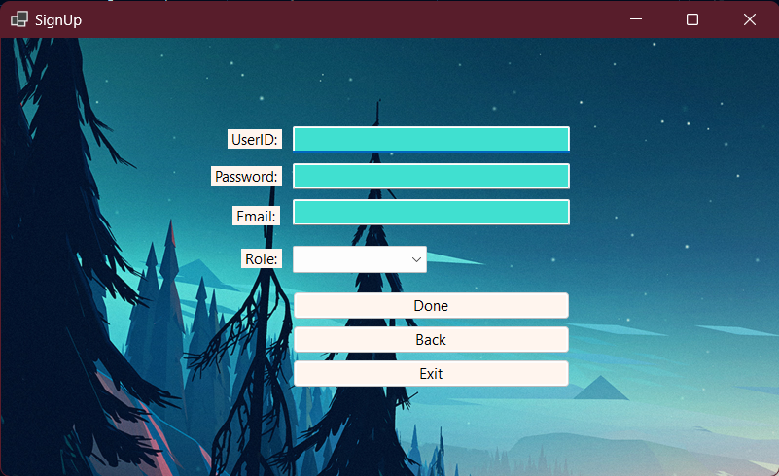
Sign-Up Page:
Registration Page

Slide 6
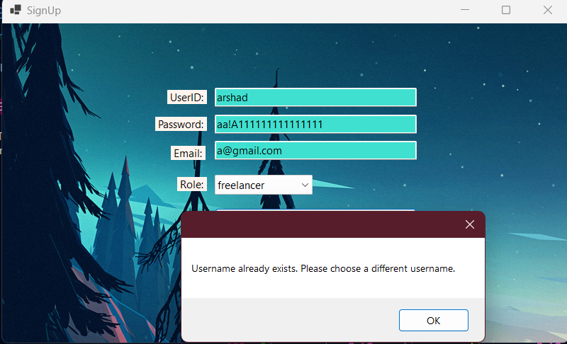
Sign-Up Page:
2. Unique username:

Slide 7
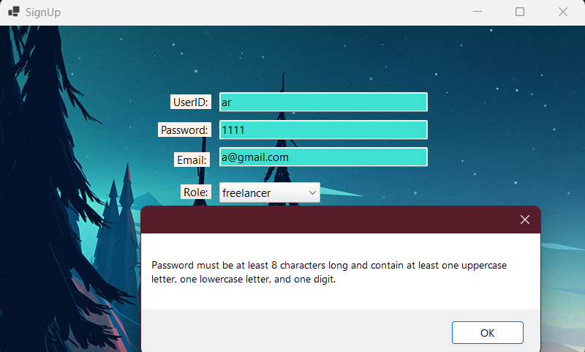
Sign-Up Page:
3. Password :

Slide 8
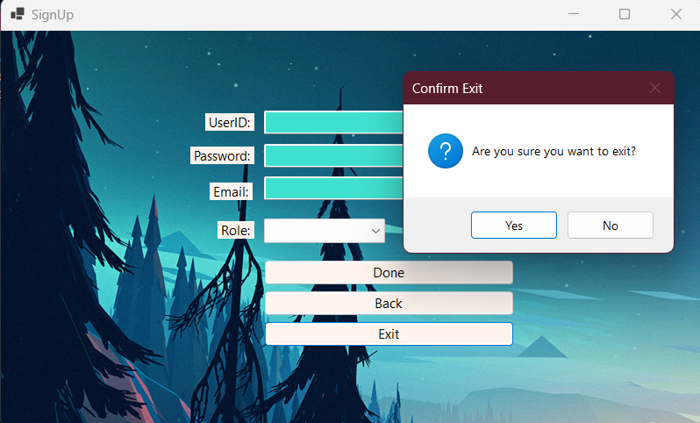
Sign-Up Page:
4. Exit Button:

Slide 9
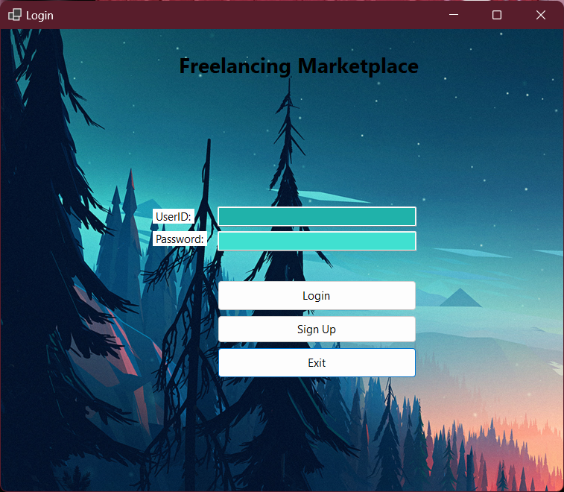
Login Pages
Login Page

Slide 10
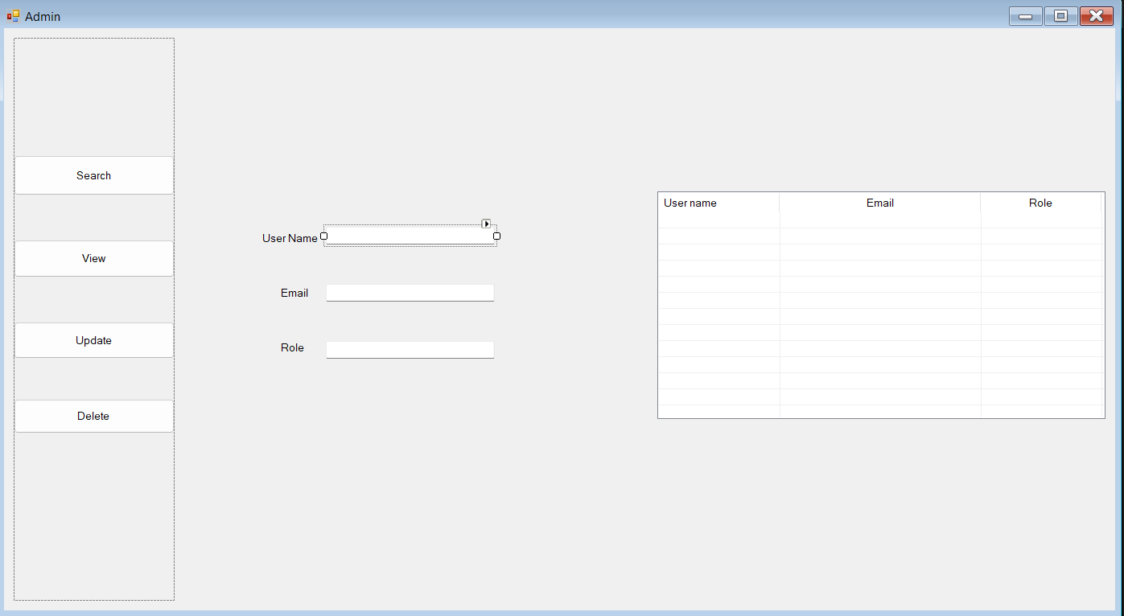
Admin Page:
Admin page with curd functionality:

Slide 11
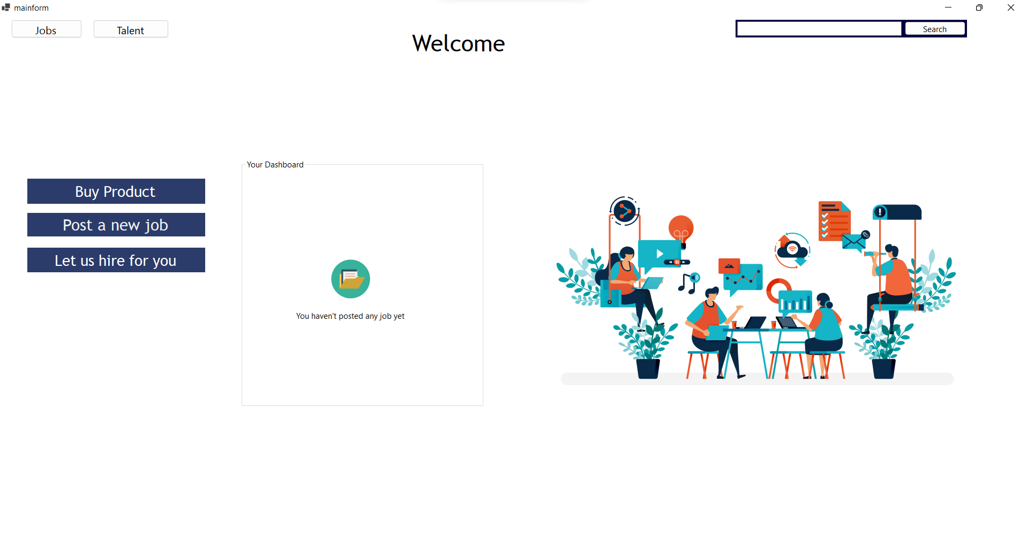
Recruiter Page:
1.LANDING PAGE:

Slide 12
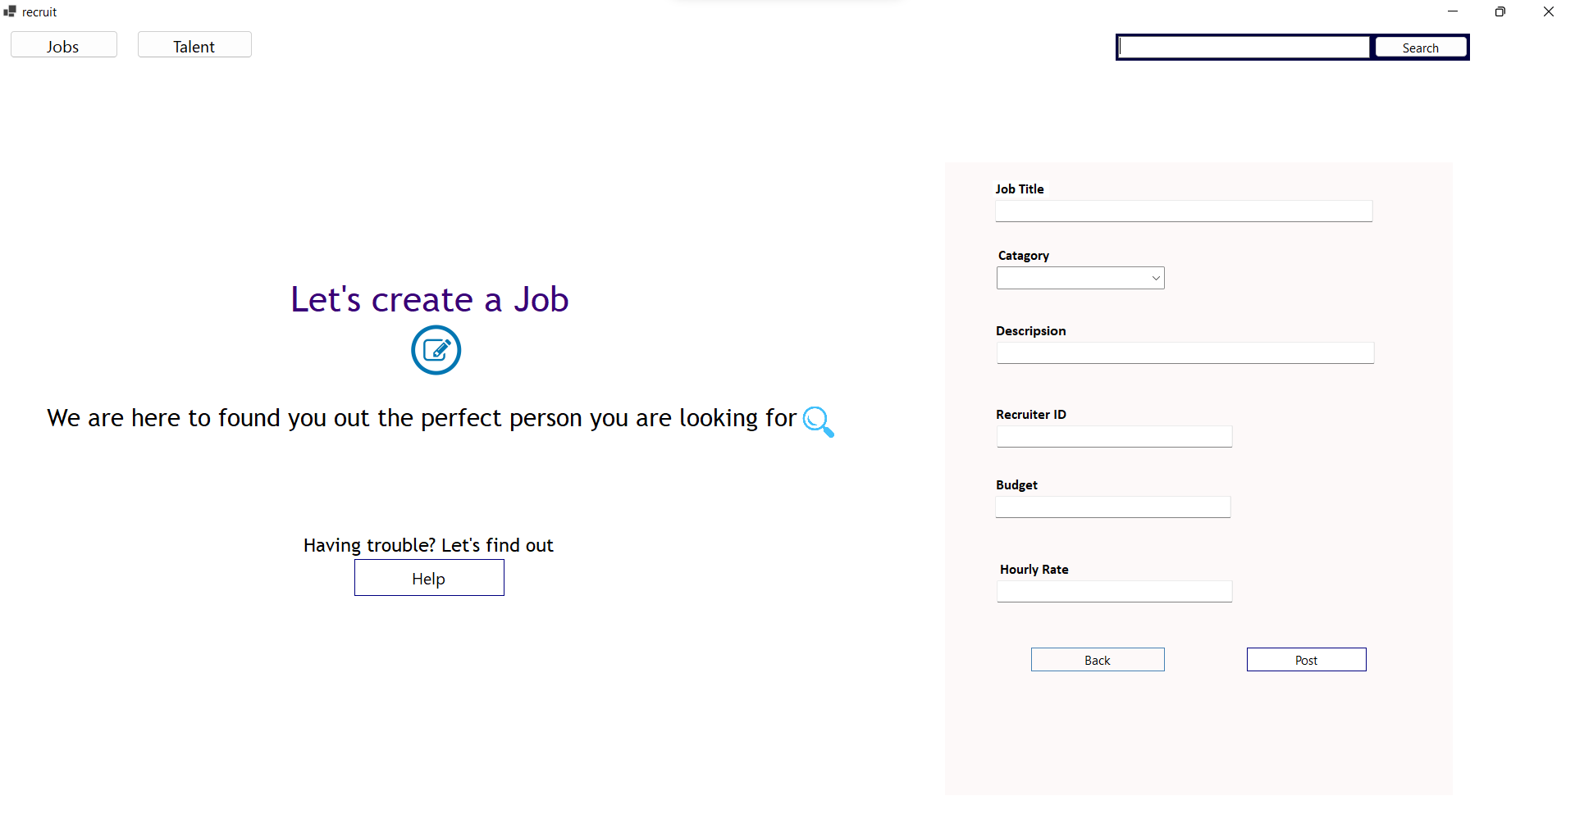
Recruiter Page:
2. Post new Job Page:

Slide 13
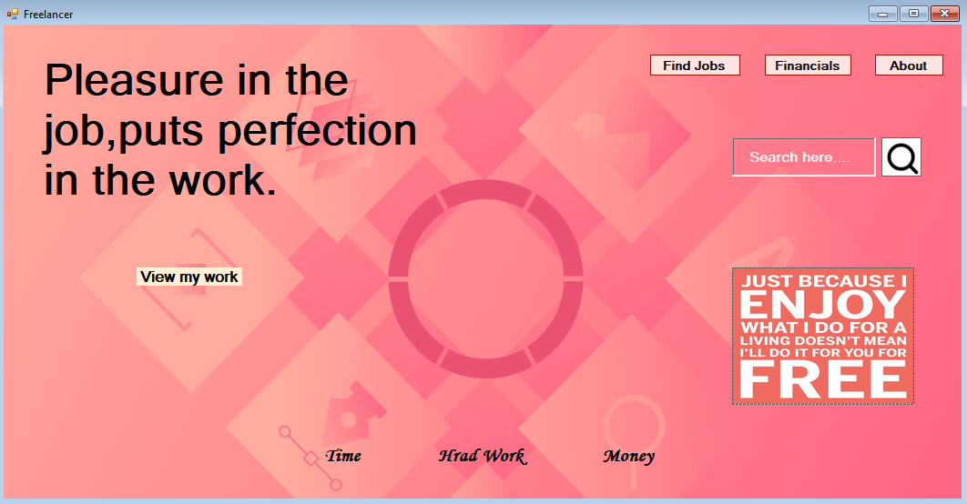
Freelancer Page:
Landing Page:
Find Jobs – Freelancer can find jobs from here.
Financials – Freelancer can see all the financials status from this .
About- Where freelancers skill, ability and all information can be seen.

Slide 14
THANK YOU

